Slide 1
STACK OPERATIONS AND PROCEDURES
Computer Organization and Assembly Language
Lec#19&20
Computer Science Department
National University of Modern Languages
Islamabad

Slide 2
STACK OPERATIONS
Runtime Stack
PUSH Operation
POP Operation
PUSH and POP Instructions
Using PUSH and POP
Example: Reversing a String
Related Instructions

Slide 3
RUNTIME STACK
Imagine a stack of plates . . .
  plates are only added to the top
  plates are only removed from the top
  LIFO (Last-In, First-Out) structure
  Push & pop operations

Slide 4
RUNTIME STACK
Managed by the CPU, using two registers
  SS (stack segment)
  ESP (stack pointer) *
SS
* SP in Real-address mode

Slide 5
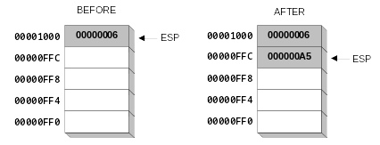
PUSH OPERATION
A 32-bit push operation decrements the stack pointer by 4 and copies a value into the location pointed to by the stack pointer.
PUSH 0A5h

Slide 6
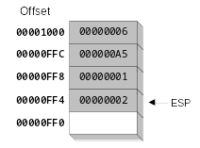
PUSH OPERATION (CONT.)
Same stack after pushing two more integers:
The stack grows downward. The area below ESP is always available (unless the stack has overflowed).

Slide 7
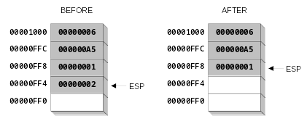
POP OPERATION
Copies value at stack[ESP] into a register or variable.
Adds n to ESP, where n is either 2 or 4.
  value of n depends on the attribute of the operand receiving the data
Pop EAX
EAX = 00000002

Slide 8
PUSH AND POP INSTRUCTIONS
PUSH syntax:
  PUSH r/m16
  PUSH r/m32
  PUSH imm32
POP syntax:
  POP r/m16
  POP r/m32

Slide 9
WHEN TO USE STACKS
To save and restore registers
To save return address of a procedure
To pass arguments
To support local variables

Slide 10
DEFINING AND USING PROCEDURES
Creating Procedures
Example: SumOf Procedure
CALL and RET Instructions
Nested Procedure Calls
Local and Global Labels
Procedure Parameters
USES Operator

Slide 11
CREATING PROCEDURES
Procedure
  A named block of statements that ends in a return statement
A procedure is the ASM equivalent of a Java or C++ function
Following is an assembly language procedure named sample:
sample PROC
  .
  .
  ret
sample ENDP

Slide 12
EXAMPLE: SUMOF PROCEDURE
;---------------------------------------------------------
SumOf PROC
;
; Calculates and returns the sum of three 32-bit integers.
; Receives: EAX, EBX, ECX, the three integers. May be
; signed or unsigned.
; Returns: EAX = sum, and the status flags (Carry,
; Overflow, etc.) are changed.
; Requires: nothing
;---------------------------------------------------------
  add eax,ebx
  add eax,ecx
  ret
SumOf ENDP

Slide 13
CALL AND RET INSTRUCTIONS
The CALL instruction calls a procedure
  pushes offset of next instruction on the stack
  copies the address of the called procedure into EIP
    ESP = ESP - 4 ; push return address
    SS:ESP = EIP ; onto the stack
    EIP = EIP + relative offset (or displacement)
    ; update EIP to point to procedure
The RET instruction returns from a procedure
  pops top of stack into EIP
    EIP = SS:ESP ; pop return address
    ESP = ESP + 4 ; from the stack

Slide 14
CALL-RET EXAMPLE
main PROC
  00000020 call MySub
  00000025 mov eax,ebx
  .
  .
main ENDP
MySub PROC
  00000040 mov eax,edx
  .
  .
  ret
MySub ENDP
0000025 is the offset of the instruction immediately following the CALL instruction
00000040 is the offset of the first instruction inside MySub

Slide 15

CALL-RET EXAMPLE (CONT.)
The CALL instruction pushes 00000025 onto the stack, and loads 00000040 into EIP
The RET instruction pops 00000025 from the stack into EIP
(stack shown before RET executes)

Slide 16
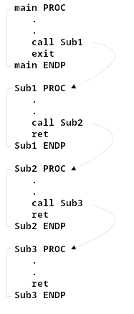
NESTED PROCEDURE CALLS
By the time Sub3 is called, the stack contains all three return addresses:

Slide 17
LOCAL AND GLOBAL LABELS
A local label is visible only to statements inside the same procedure. A global label is visible everywhere.
main PROC
jmp L2 ; error
L1:: ; global label
exit
main ENDP
sub2 PROC
L2: ; local label
jmp L1 ; ok
ret
sub2 ENDP

Slide 18
PARAMETER PASSING MECHANISMS
Call-by-value
  Receives only values
  Similar to mathematical functions
Call-by-reference
  Receives pointers
  Directly manipulates parameter storage

Slide 19
PARAMETER PASSING
Parameter passing is different and complicated than in a high-level language
In assembly language
  You should first place all required parameters in a mutually accessible storage area
  Then call the procedure
Types of storage area used
  Registers (general-purpose registers are used)
  Memory (stack is used)
Two common methods of parameter passing:
  Register method
  Stack method

Slide 20
PARAMETER PASSING: REGISTER METHOD
The ArraySum procedure calculates the sum of an array. It makes two references to specific variable names:
Call-by-reference
ArraySum PROC
  mov esi,0 ; array index
  mov eax,0 ; set the sum to zero
mov ecx,LENGTHOF myarray ; set number of elements
L1: add eax,myArray[esi] ; add each integer to sum
  add esi,4 ; point to next integer
  loop L1 ; repeat for array size
  mov theSum,eax ; store the sum
ret
ArraySum ENDP
What if you wanted to calculate the sum of two or three arrays within the same program?

Slide 21
PROCEDURE PARAMETERS (CONT.)
This version of ArraySum returns the sum of any doubleword array whose address is in ESI. The sum is returned in EAX:
ArraySum PROC
; Receives: ESI points to an array of doublewords,
; ECX = number of array elements.
; Returns: EAX = sum
;-----------------------------------------------------
  mov eax,0 ; set the sum to zero
L1: add eax,[esi] ; add each integer to sum
  add esi,4 ; point to next integer
  loop L1 ; repeat for array size
ret
ArraySum ENDP

Slide 22
CALLING ARRAYSUM
.data
array DWORD 10000h, 20000h, 30000h, 40000h
theSum DWORD ?
.code
main PROC
mov esi, OFFSET array
mov ecx, LENGTHOF array
call ArraySum
mov theSum, eax

Slide 23
WHEN NOT TO PUSH A REGISTER
The sum of the three registers is stored in EAX on line (3), but the POP instruction replaces it with the starting value of EAX on line (4):
SumOf PROC ; sum of three integers
  push eax ; 1
  add eax,ebx ; 2
  add eax,ecx ; 3
  pop eax ; 4
  ret
SumOf ENDP
Call-by-value
SumOf PROC ; sum of three integers
  add eax,ebx ; 2
  add eax,ecx ; 3
  ret
SumOf ENDP

Slide 24
PROS AND CONS OF THE REGISTER METHOD
Advantages
  Convenient and easier
  Faster
Disadvantages
  Only a few parameters can be passed using the register method
      Only a small number of registers are available
  Often these registers are not free
      freeing them by pushing their values onto the stack negates the second advantage

Slide 25
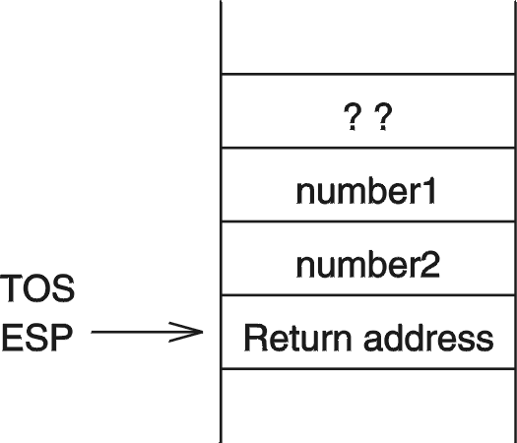
PARAMETER PASSING: STACK METHOD
All parameter values are pushed onto the stack before calling the procedure
Example:
    push number1
    push number2
    call sum

Slide 26
ACCESSING PARAMETERS ON THE STACK
Parameter values are buried inside the stack
We can use the following to read number2
    mov EBX,[ESP+4]
Problem: The ESP value changes with push and pop operations
    Relative offset depends on the stack operations performed
Is there a better alternative?
  Use EBP to access parameters on the stack

Slide 27
USING BP REGISTER TO ACCESS PARAMETERS
Preferred method of accessing parameters on the stack is
    mov EBP,ESP
    mov EAX,[EBP+4]
to access number2 in the previous example
Problem: BP contents are lost!
  We have to preserve the contents of BP
  Use the stack (caution: offset value changes)
    push EBP
    mov EBP,ESP

Slide 28
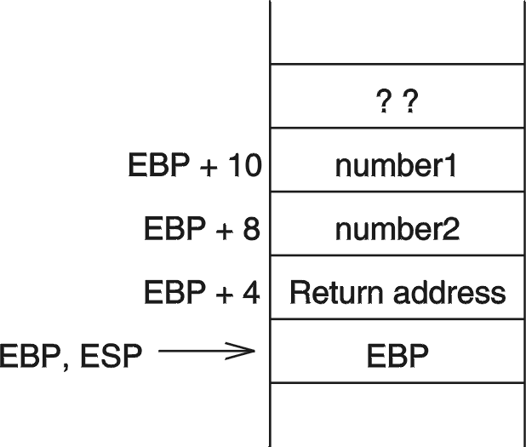
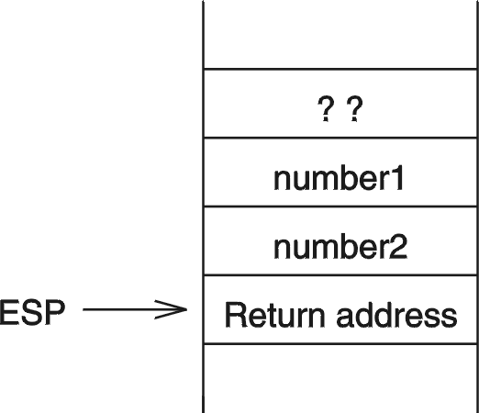
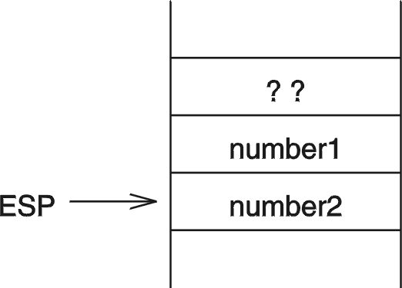
CLEARING THE STACK PARAMETERS
Stack state after
saving EBP
Stack state after
pop EBP
Stack state after
executing ret

Slide 29
REFERENCE
Assembly Language for Intel-Based Computer
Kip R. Irvine
4th edition
Chapter 5

Slide 30
Quiz

